Slide 1
DisasTM Accidental record App
-Satyendra Chandan

Slide 2
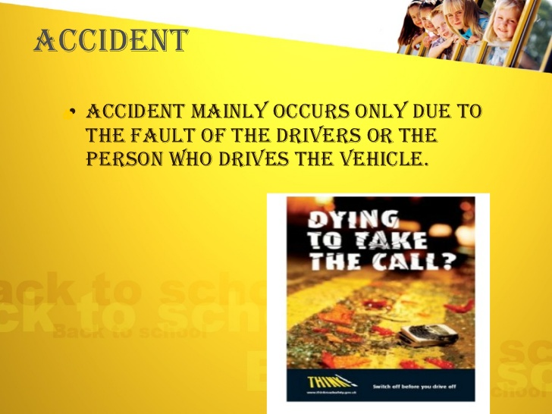

Slide 3
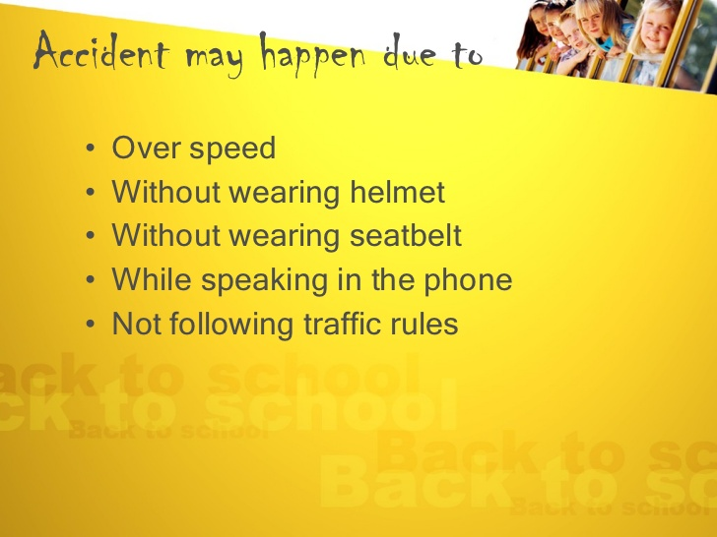
TO COVER THE ACCIDENTAL INSURANCE CLAIM YOU NEED SOME PROOF OF ACCIDENT.
LIKE AN IMAGE OR FOOTAGE.
TO RESOLVE THIS ISSUE WE HAVE AN APP

Slide 4

INTRODUCING TO YOU AN ALL NEW APP
DisasTM
Accidental record App

Slide 5
WHAT IS DisasTM?
Here DisasTM stands for Disaster Time Machine
Suppose you are on your vehicle and you lunch the app and place it in front of you road view.
it continuously takes images stores it in your phones memory and creates a signature of the image captured and sends the signature to the insurance company database.
It uses Local binary pattern and MD5 algorithm for tought image verfication.
God forbid if you met with an accident then you take your images captured by the app and show it to the insurance company. They will verify against the correct signature and you will get your insurance claim back.

Slide 6
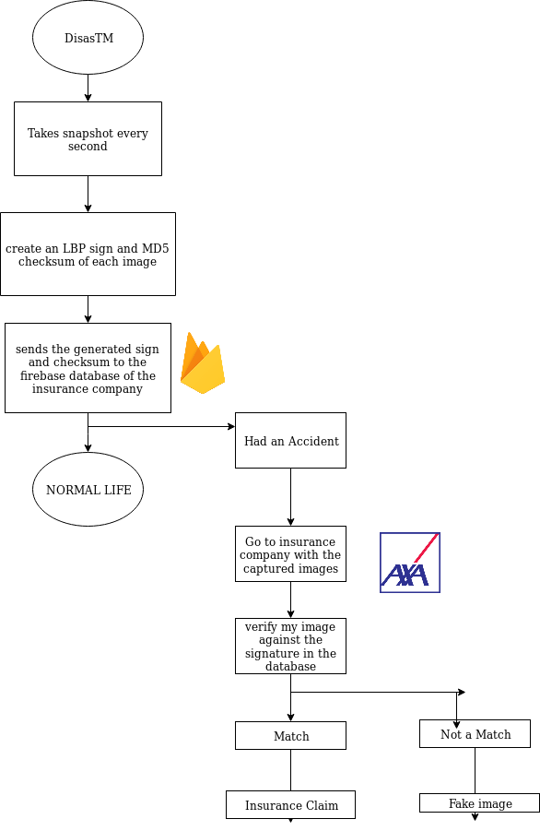
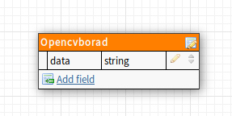
Flow of DisasTM App?
DATABASE SCHEMA

Slide 7
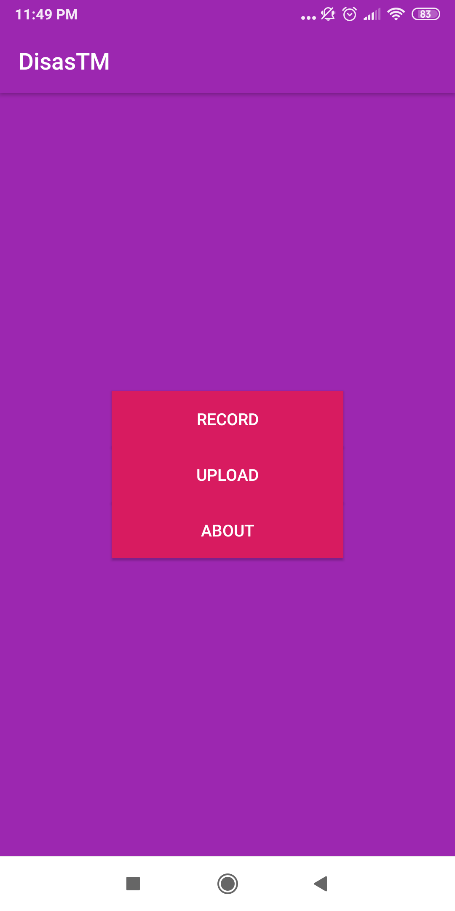
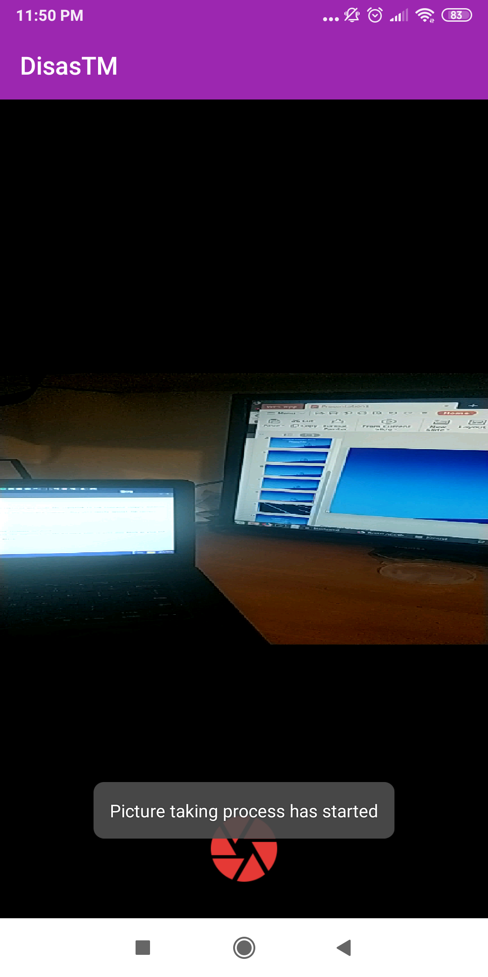
Camera View Continuously Take Snapshots of the view
This is how DataTM looks

Slide 8
FIREBASE DATABASE REALTIME SIGNATURE UPLOAD

Slide 9
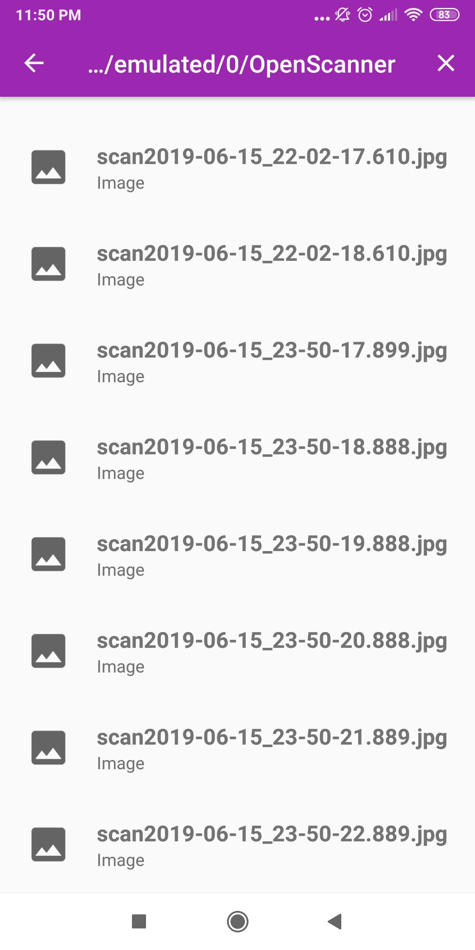
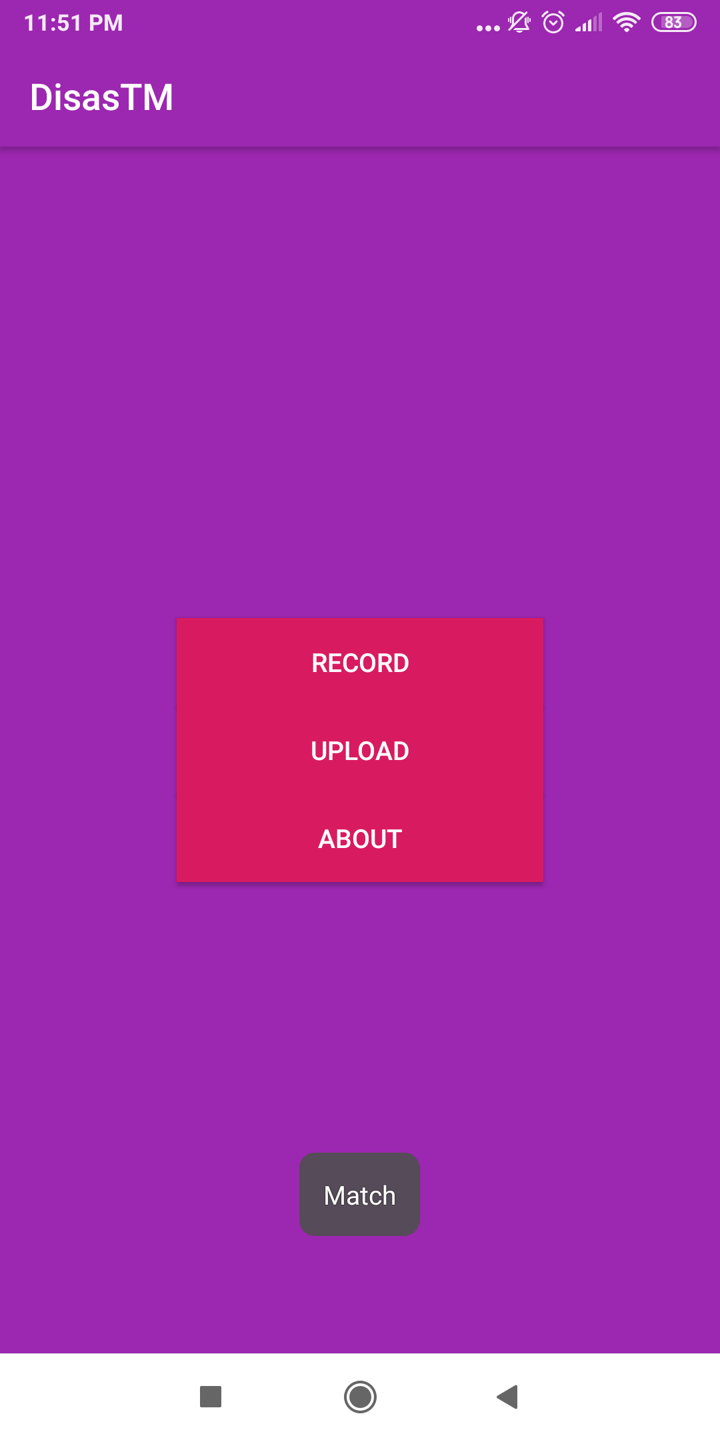
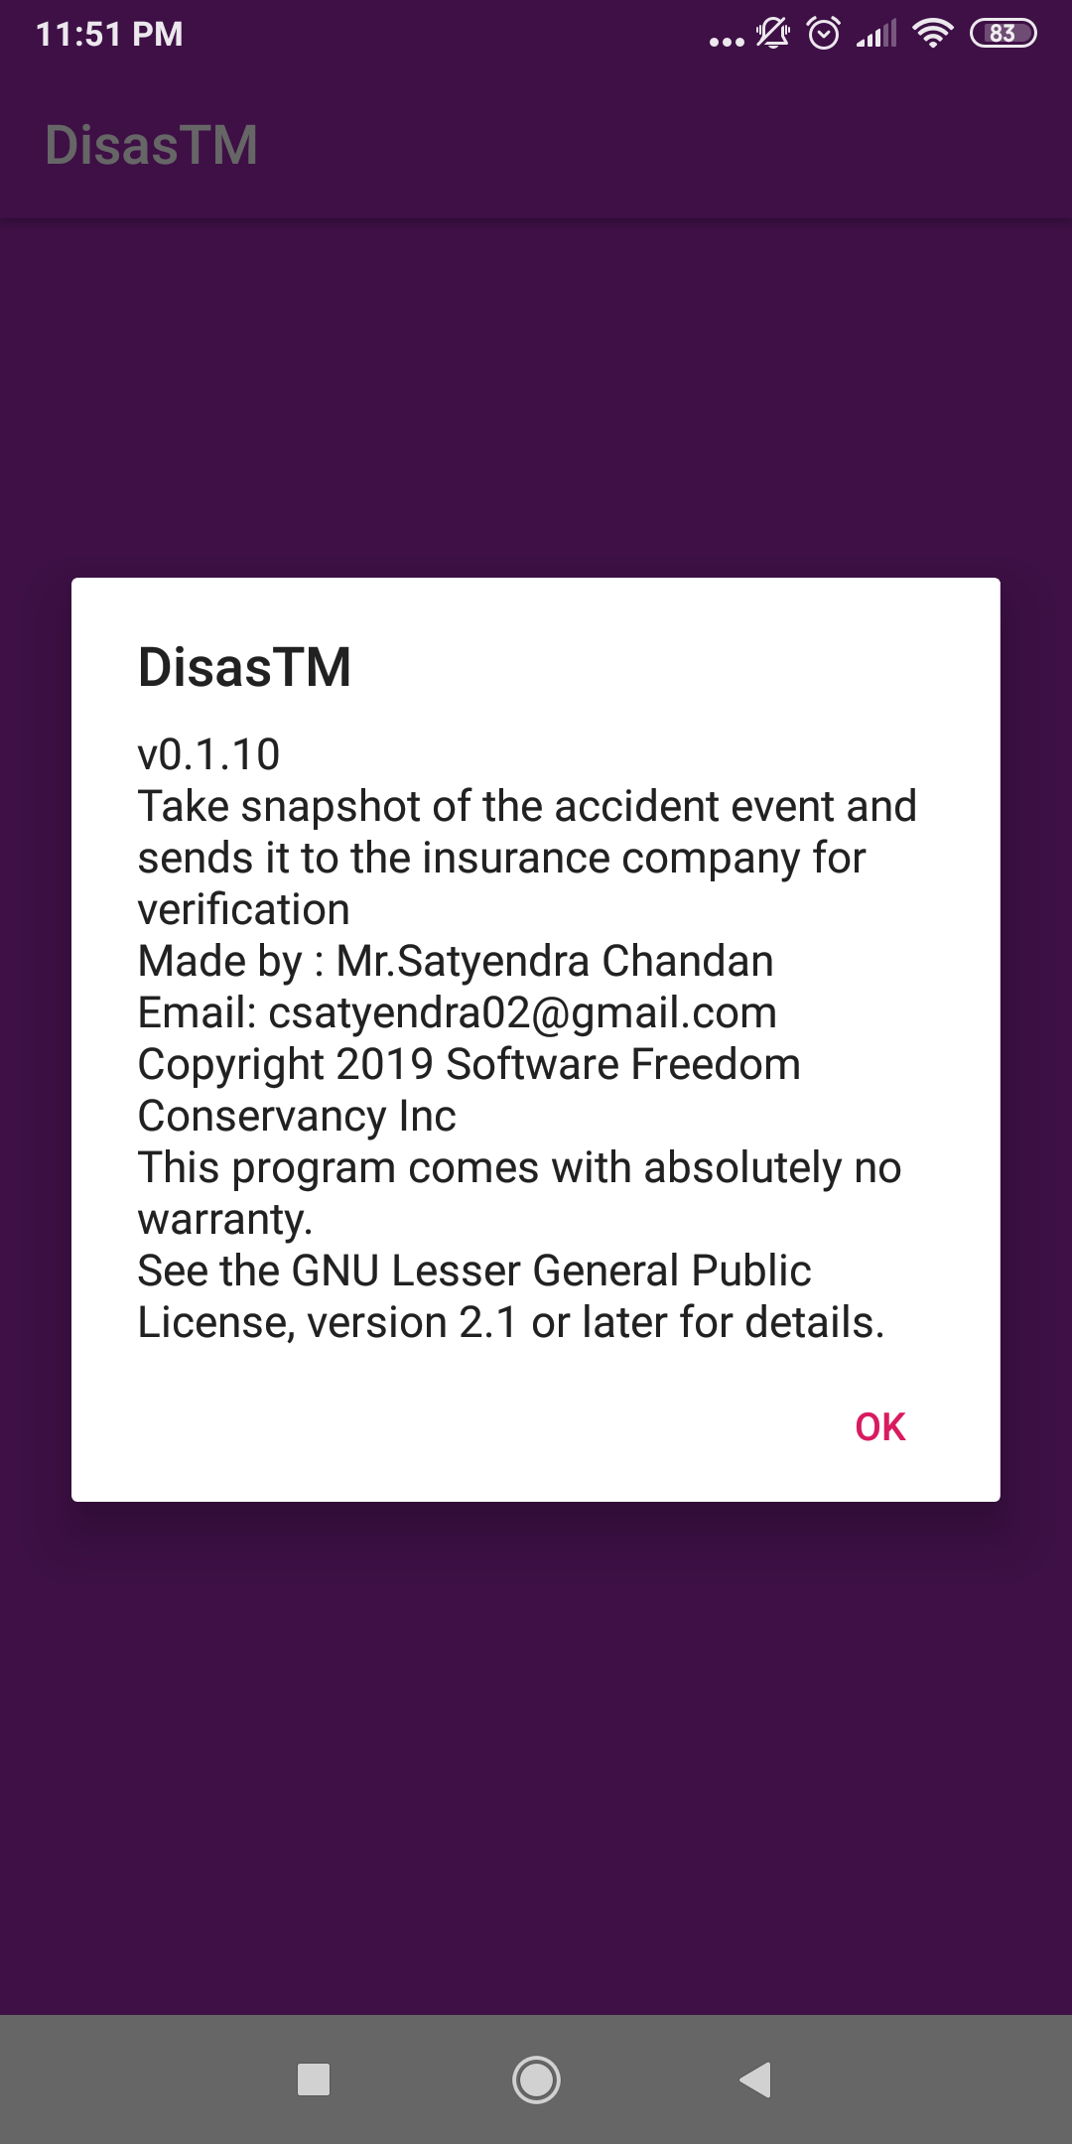
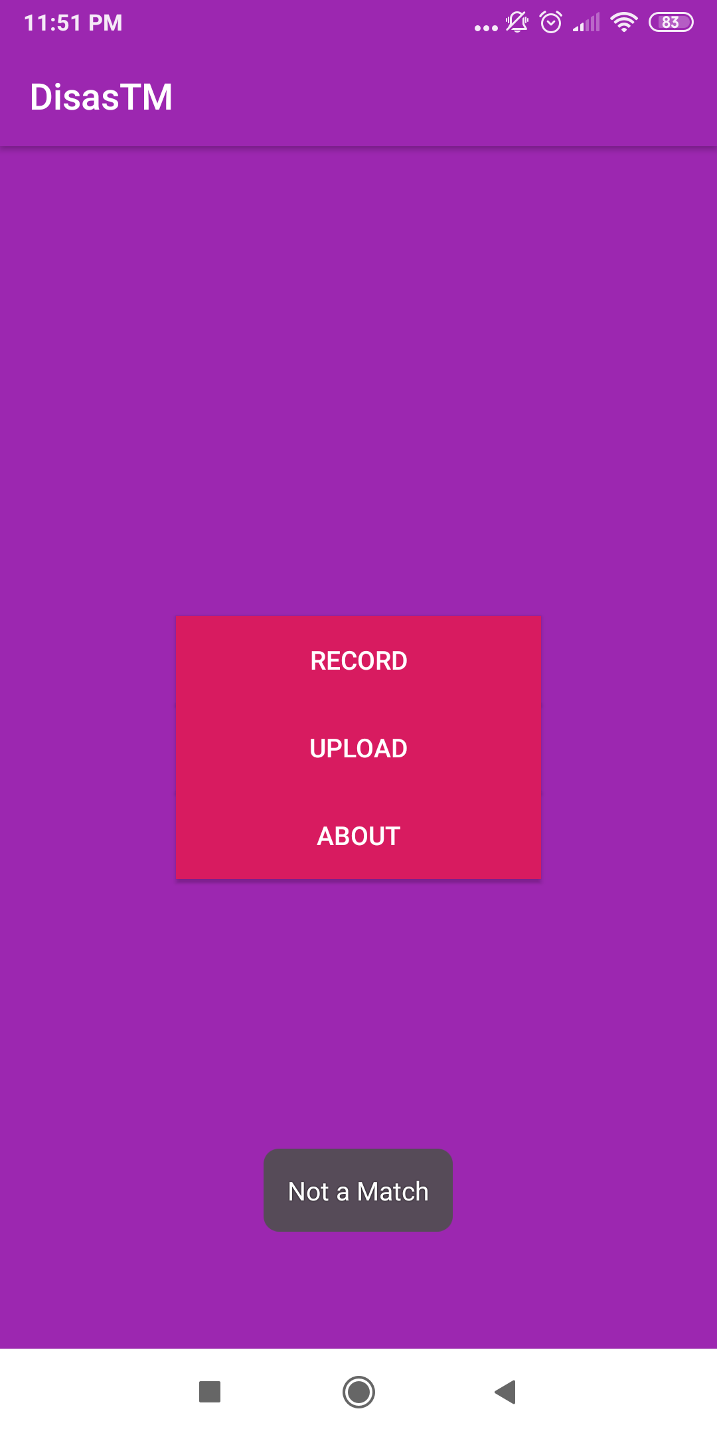
Select The captured Image
Verifies against LBP and MD5. Match found
Non captured image. No Match
ABOUT THE APP

Slide 10


Slide 11
THANK YOU
ANY QUESTIONS?

